Slide 1









Team Name : The Decider
Team Leader : Mukesh Dubey
I4c Id : 18981
Nodal Center : NDIM

Slide 2


Idea/Approach & Details
Ministry Category : AICTE/MHRD
Problem Statement : Dashboard For All MHRD Initiatives & Schemes
Team Leader : Mukesh Dubey
i4c id : 18981
Problem Code : #AICTE2
College Code : 1-3327699129
Nodal Center : NDIM

Slide 3

Problem Statement
“ To Design and Develop the Dashboard For All MHRD Initiatives & Schemes “

Slide 4
Solution / Approach

Slide 5
Research & Analysis.
Data Modeling.
Design.
Implementation / Development.

Slide 6
1. Research & Analysis
Visited various Govt. Websites ( mhrd.gov.in, www.aicte-india.org/, www.india.gov.in )
Analyzing solution to the existing problems and how we can improve to make it more better.

Slide 7
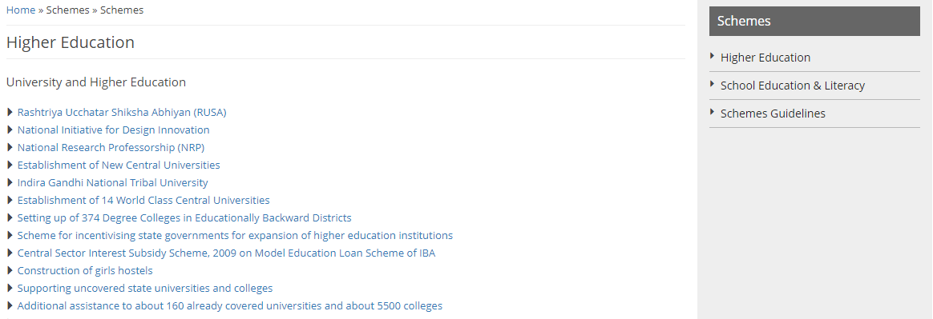

Slide 8
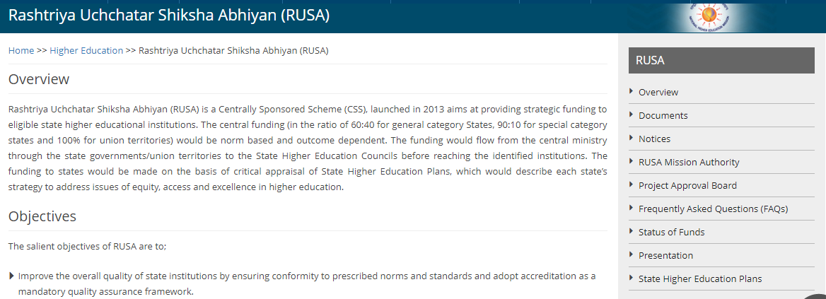

Slide 9
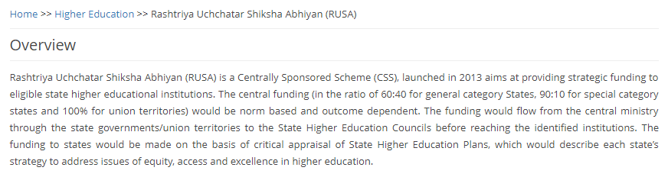
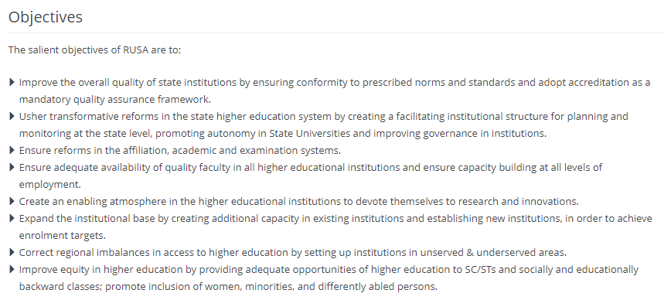

Slide 10
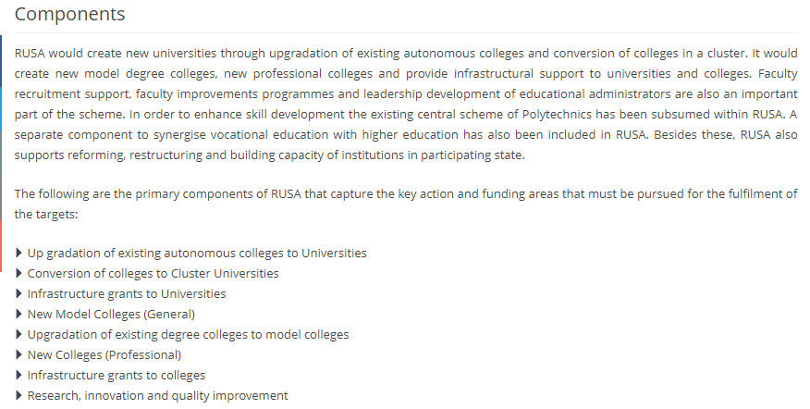

Slide 11
2. Data Modeling
Extracting the useful information (Schemes, overview, objective, scheme components, eligibility criteria, FaQ’s etc.) from the raw data which we collected at previous stage.
Storing the useful information to our database in the form of data model.

Slide 12
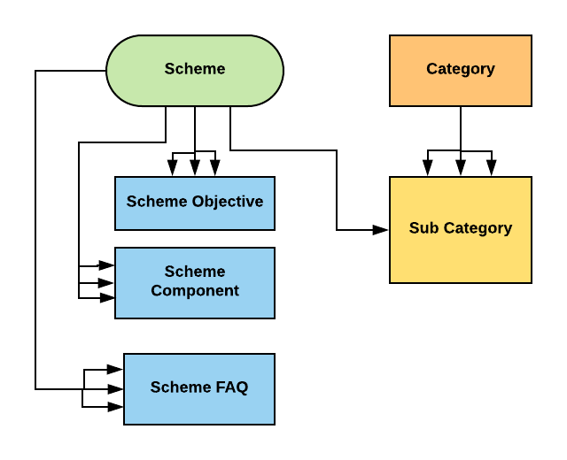
Defining Relationships.

Slide 13
3. Designing
Using Frontend Technologies.

Slide 14
4. Implementation & Development

Slide 15
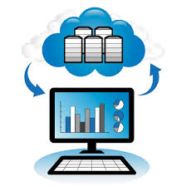
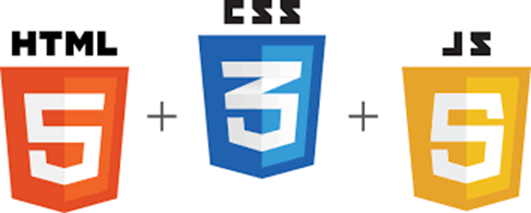
a.) Technology Stack
Front-End Technologies
Back-End Technologies
HTLM 5
CSS 3
JAVASCRIPT
AJAX
Python (Django Framework)
RDBMS (Postgresql)
Tool Used
VCS Git & Gitlab

Slide 16
b.) Django Framework
Most Popular high-level Python Web framework.
Encourages rapid development.
It’s free and open source.
Takes care of much of the hassle of Web development.
We only have to focus on writing your app without needing to reinvent the wheel.
Don’t repeat yourself (DRY programming) is an integral part of Django principles.
Supports Oops Concept (Inheritence).

Slide 17
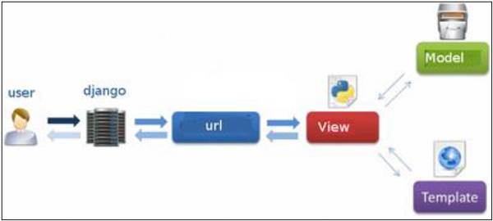
c) MVT Design Pattern
Django has been referred to as an MVT framework

Slide 18
MVT
Model :- (Data in form of Python Classes )
View :-
(Implements the Business Logic)
Template :- (Presentation of data to user)

Slide 19
Database
RDBMS :- postgresql

Slide 20
d.) Django ORM
An ORM is a code library that automates the transfer of data stored in relational databases tables into objects.
Each class is a database table and each attribute, variable represents column.
Allows the developer to write Python code instead of SQL to create, read, update and delete data and schemas in their database.
Developers can use the programming language they are comfortable with to work with a database instead of writing SQL queries.

Slide 21
Features
Dynamic Data Transfer.
Scheme Management C.R.U.D.
Chatbot Implementation (Basic) to guide user.
2 Dashboard’s
Rights to Admin and end user.

Slide 22

Website Overview
Opening The website Will redirect the User to the Homepage , Where an information About the Website, Our Ministers , Departments , Various Initiatives And Schemes , About Upcoming Scheme is Provided.
User can See the List of recently initiated Schemes on the website , and if he is interested he/she can view the list of all schemes. If user wants to enroll so as to get the benefit of scheme he has to register himself into our portal by providing some information (which are needed at the time of registration).
Otp Verification , Email Verification is provided, user data is completely secured.(Django)
After Registering he has his own user Dashboard where he can see the list of schemes in which he is enrolled , also get the knowledge of the schemes rating and many more things and he will be notified on email whenever a new schemes is launched.
An Admin Panel / Dashboard is also Provided to the user where he can Edit (add , update, delete) a new scheme or an existing scheme. Also he has the credentials to see the recently connected users , he can see the statics of how scheme is successful, he has the record of the no. of users connected with the scheme.
He can Check about the particular user by just entering any of the information and see the fastest results with in a couple of seconds.
All data is Coming to Webpage / dashboard Dynamically, Admin has provided User-Interface for that Where he can just enter the fields like (Title ,Short Description, About The Scheme, image for scheme) and the information has been updated after Submitting , there is no need to code for displaying the data.

Slide 23
Reference Used
http://mhrd.gov.in/
https://www.facilities.aicte-india.org/dashboard/pages/dashboardaicte.php
https://www.w3.org/html/
https://www.w3.org/Style/CSS/
https://www.javascript.com/

Slide 24
Any Questions ??

Slide 25
Any Feedbacks ??

